Slide 1


Online Investments Declaration
Global Payroll

Slide 2
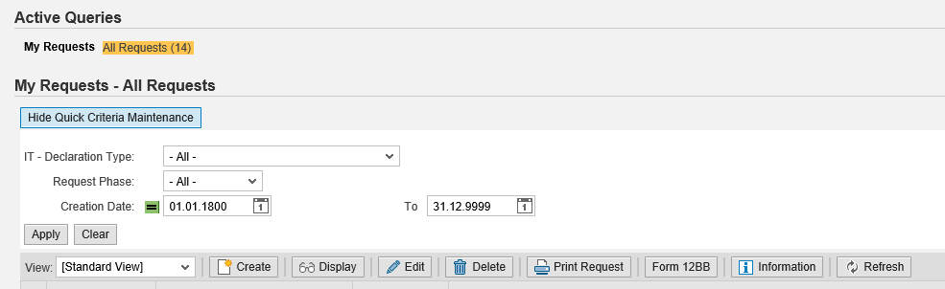
Investment proposal – Landing screen
Click on create

Slide 3
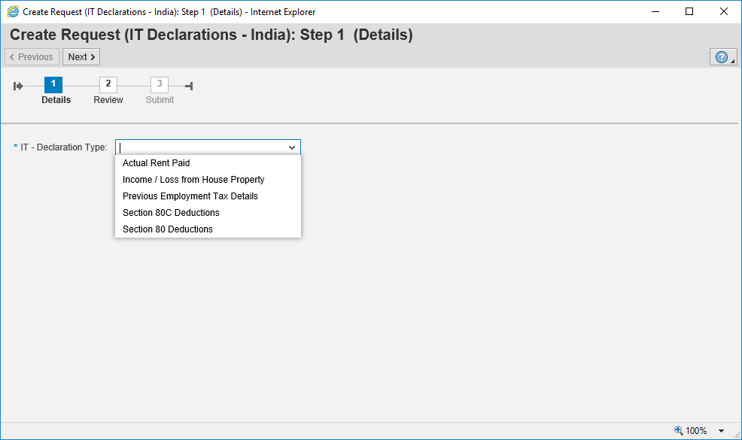
Investment proposal – IT declaration Type selection
Click next, once declaration type is selected
Click here to select option

Slide 4
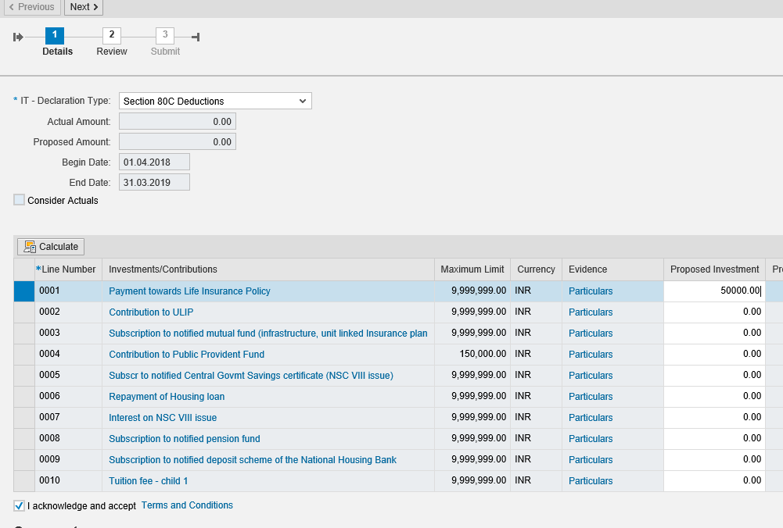
Investment proposal – 80c declarations
Enter proposed amount for each investment done by you
Tick the check box

Slide 5
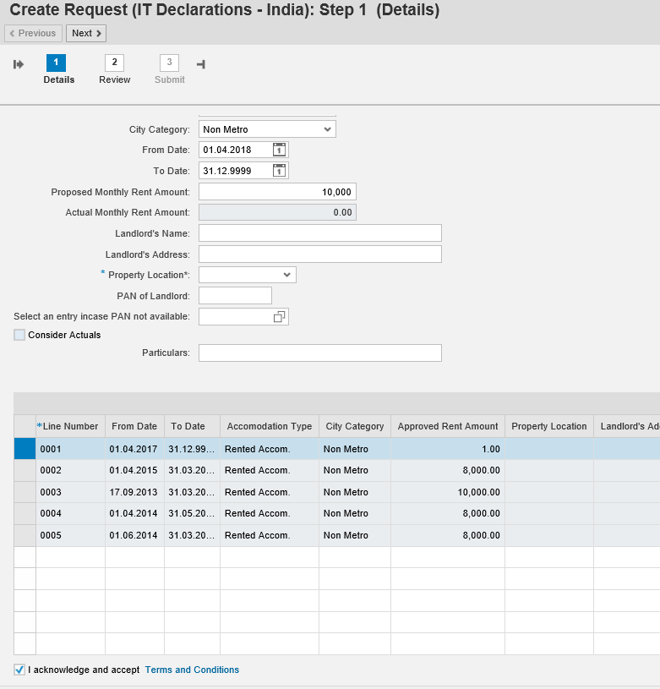
Investment proposal – House Rent Declaration
Enter proposed monthly rent amount
Enter land lord details, PAN of land lord ( If rent amount is > 8,333.33 PM )
Tick the check box

Slide 6
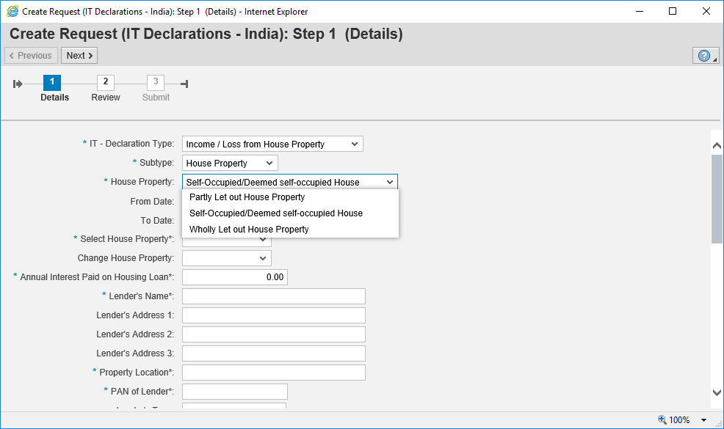

Investment proposal – Income / loss from house property
Select the required option and fill in all the tabs
Tick the check box

Slide 7
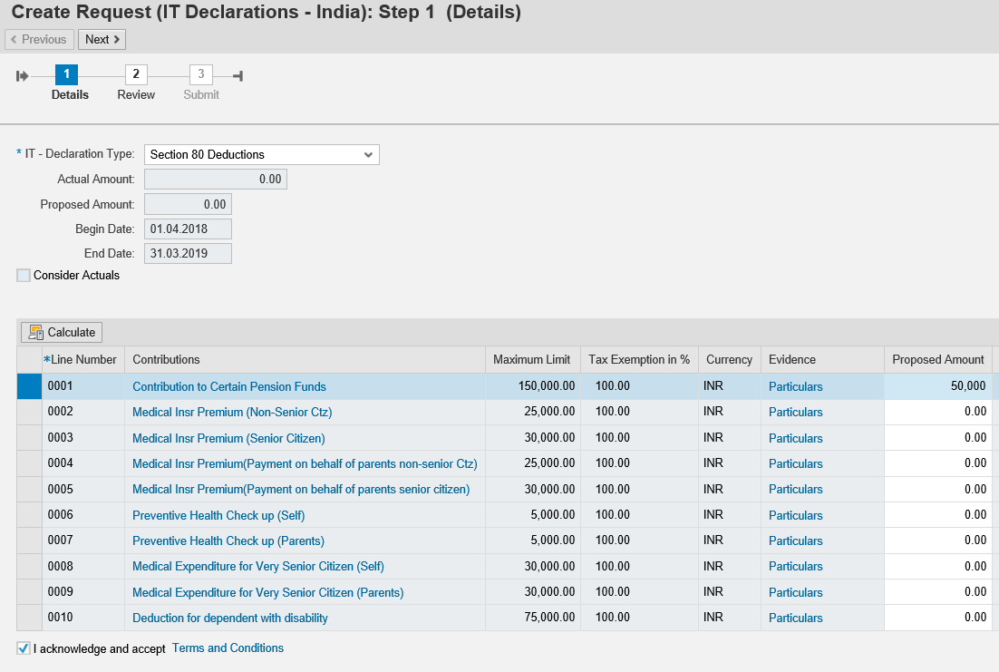
Investment proposal 80D
Enter proposed amount for each investment done by you
Tick the check box

Slide 8
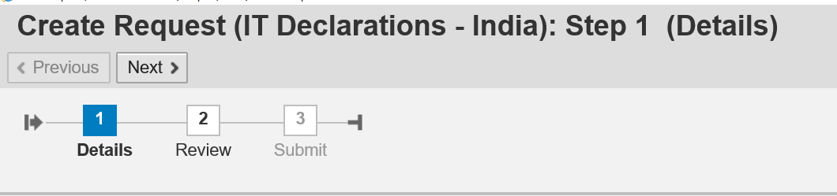
Investment proposal contnd..
Select next to proceed further
Click Submit once your declaration are reviewed to complete process
Click review once completely entered declaration

Slide 9
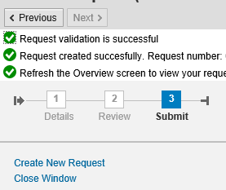
Investment proposal completion..
Make Sure this message is displayed.

Slide 10
Thank You!
HRdirect ticket

